Slide 1

Team <Blank/>
DataFest 2024

Slide 2
Introduction
Focus Area: What factors are related to student learning on CourseKata? How can students and teachers improve the virtual statistical learning experience?
Research Question: What factors predict student performance (EOC) and utility (Utility response)?

Slide 3
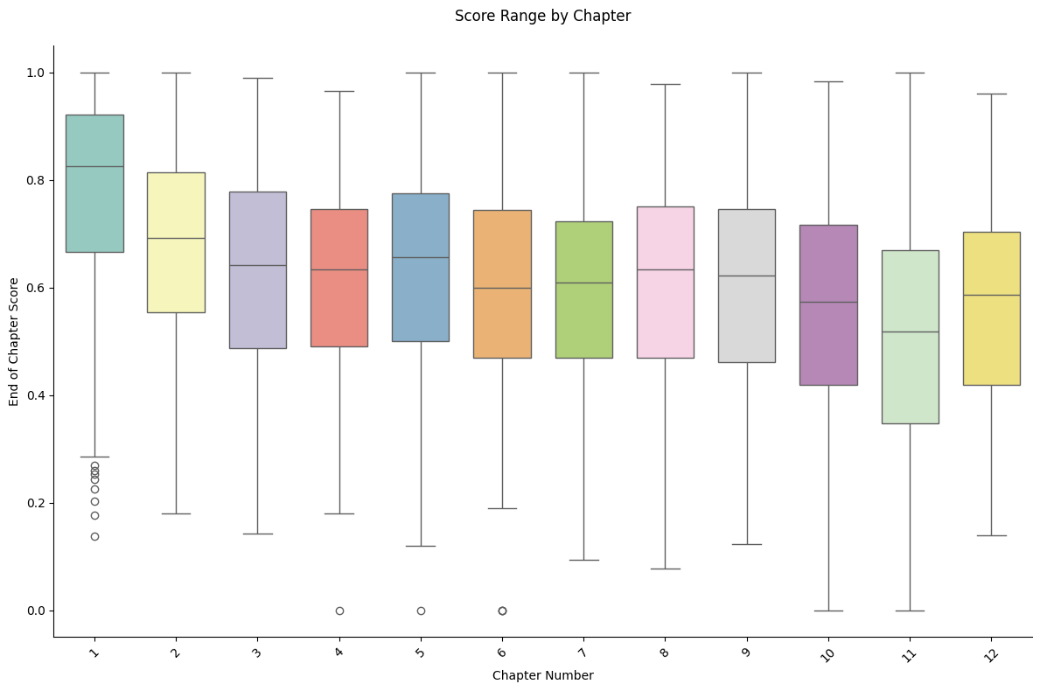
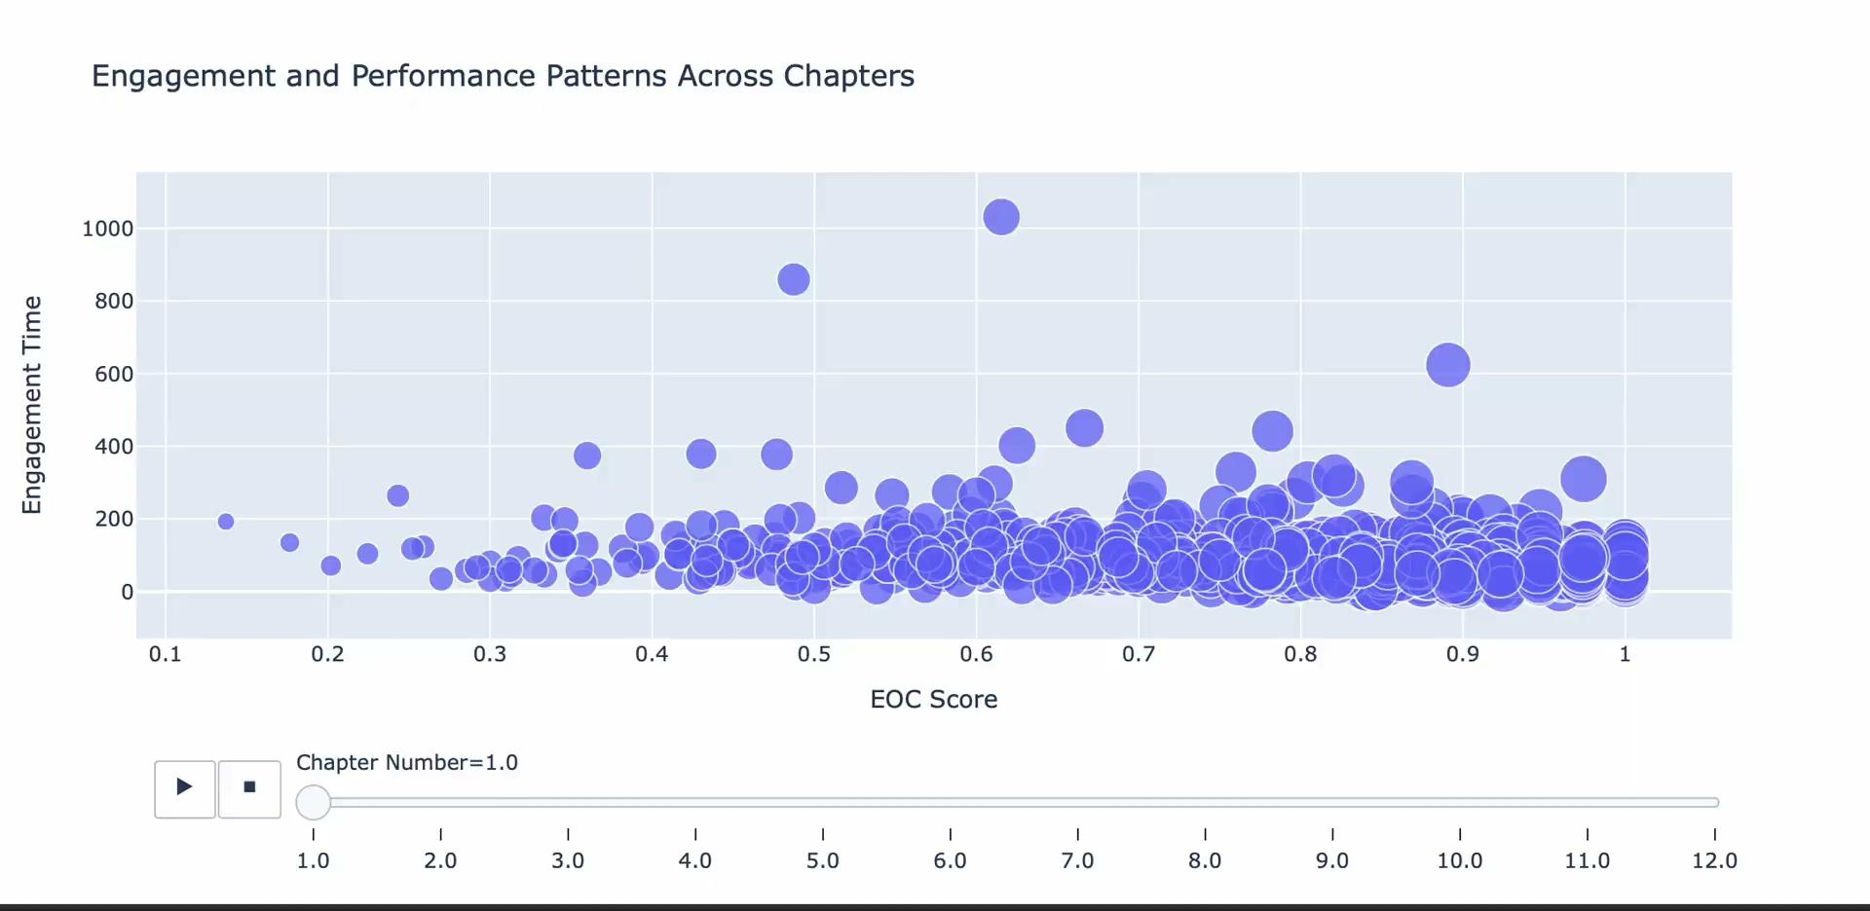
Exploratory Data Analysis

Slide 4
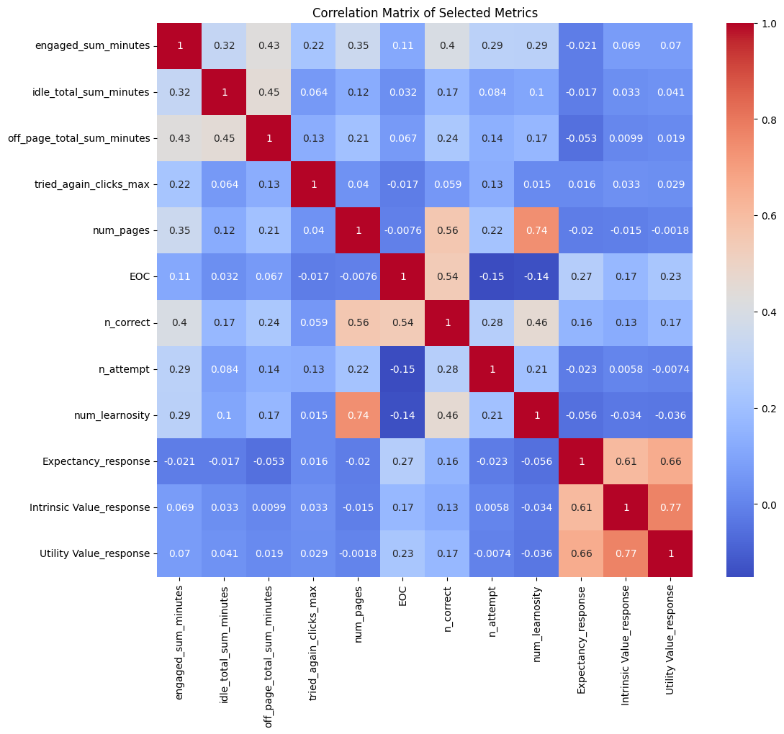
No significant linear relationship
Heated Correlation Matrix of Selected Variables

Slide 5
Variables Selection
Output: Utility Value and EOC
Input: Each chapter’s…
Book, version, institution, number of sections, number of sections with review, number of revisited sections, total engaged time, idle time, off page time, tried again, EOC, other survey responses, number of questions, activity types, total word count, and average words per section (ChartBeat)
Notes:
One important note is that we took some time to consider what key information might be missing from the data, and after researching what factors influence engagement and attention in online learning, we found a really interesting study about word count from ChartBeat. So we decided to go outside the dataset provided and bring in some data we collected about the total word count of each chapter and the average word count per section in that chapter.

Slide 6
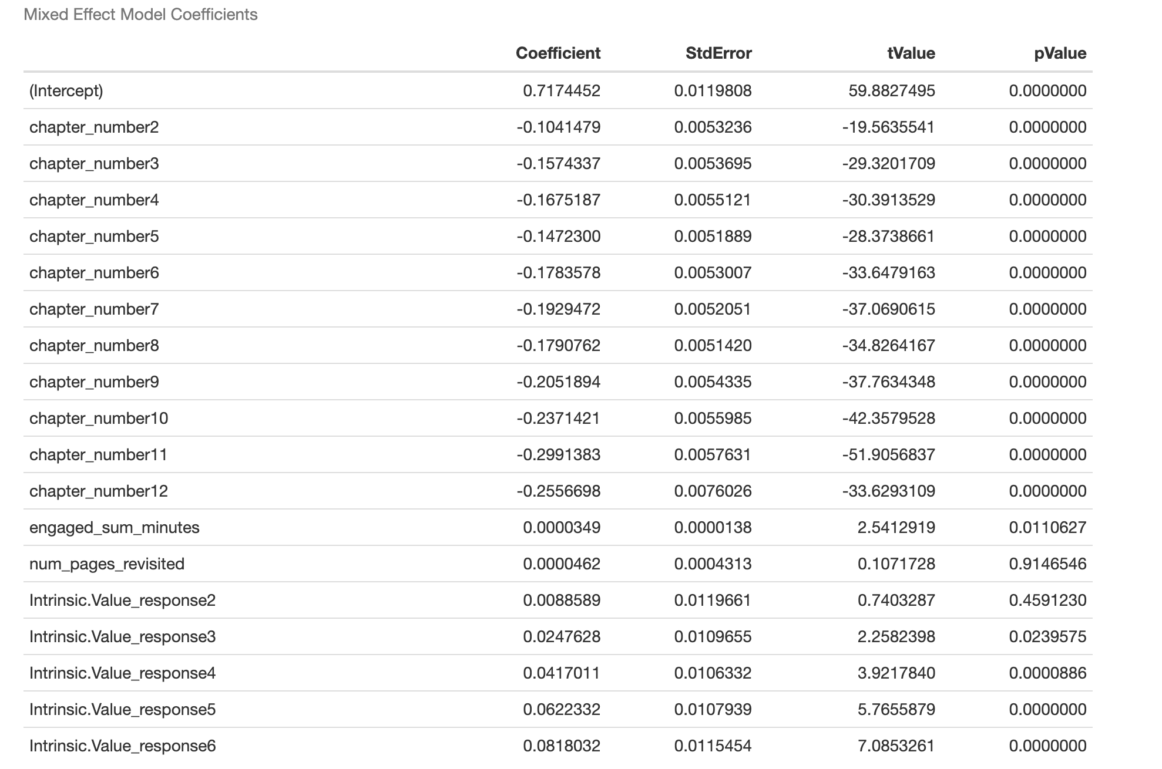
Developing Models: Mixed Effect Model

Slide 7
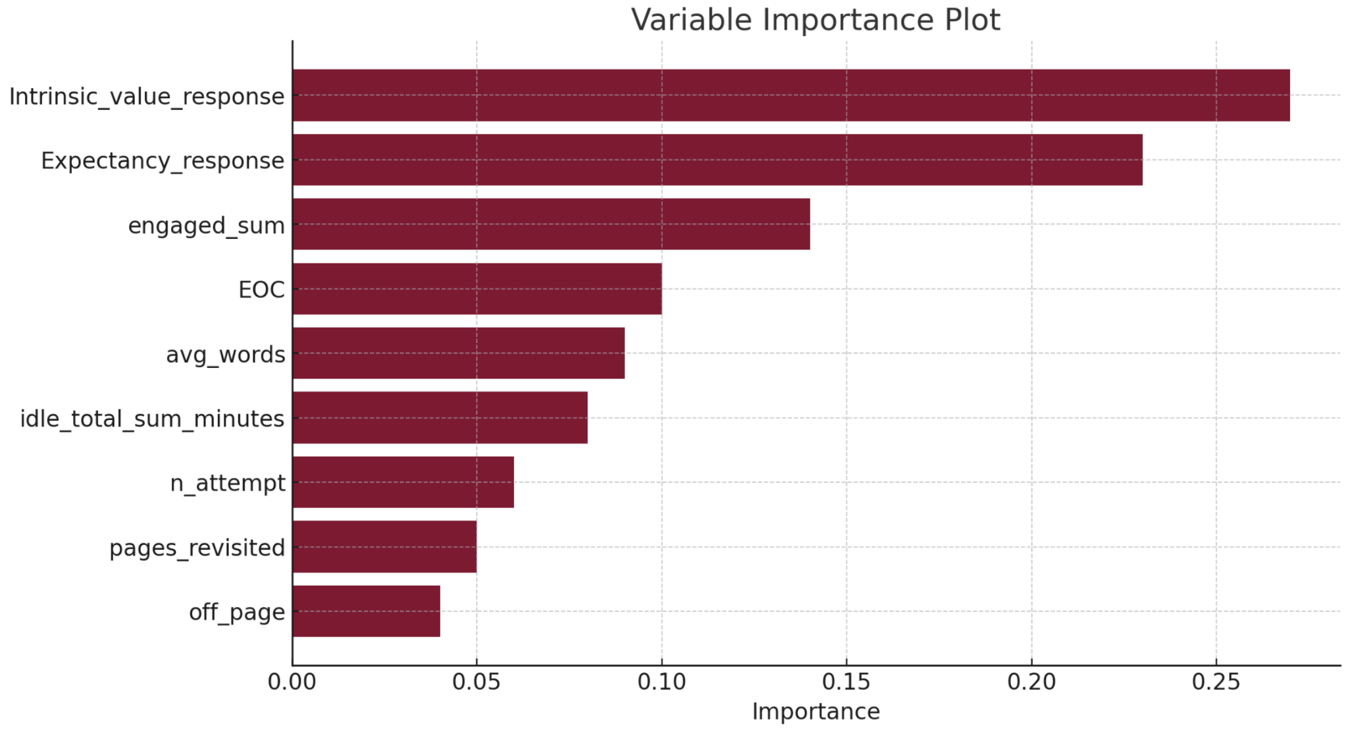
Developing Models: Random Forest
Utility value response
R²: 60.2%
R²: 65.1%
Notes:
Nonlinear data
Predicting utility value
Variable importance
R2 improved with word count

Slide 8
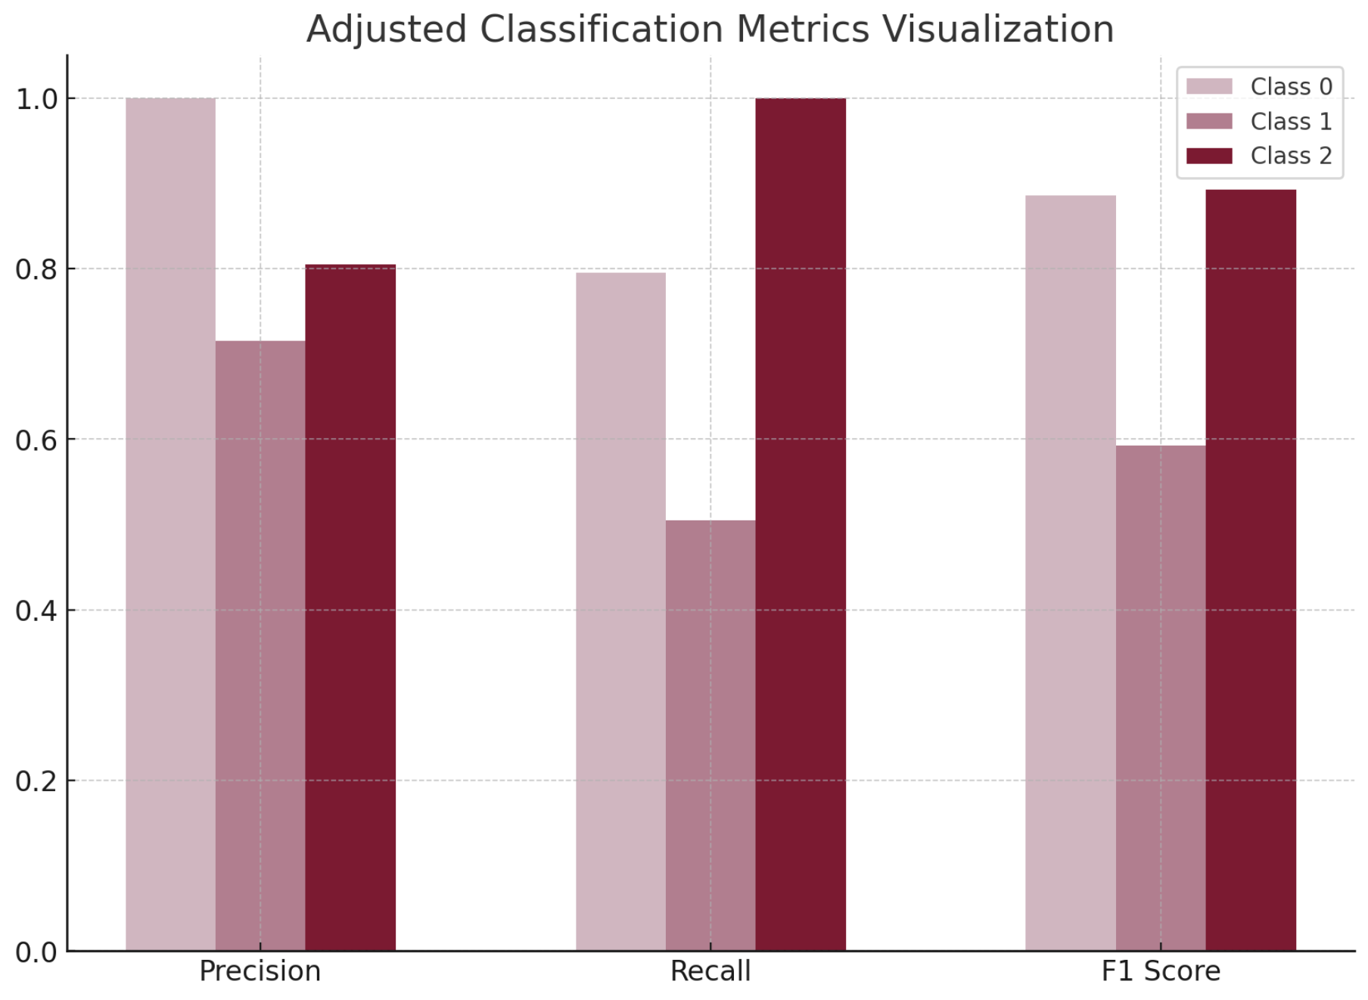
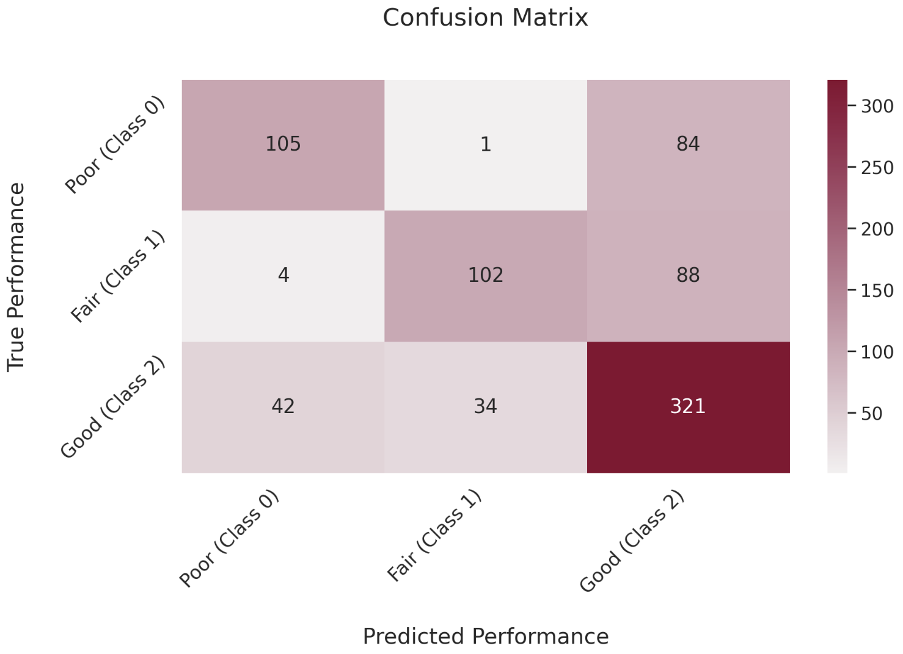
Developing Models: SVM
EOC Category:
(0 - 25 percentile),
(25 - 75 percentile),
(75 - 100 percentile)
Accuracy:
67.6%

Slide 9
Findings and Suggestions
Non-linear models yielded better results than linear models
Engagement time does not increase with chapter number or word count despite a decrease in performance (EOC)
Break up later chapters into smaller parts so students spend more time on each topic
Institution is significant in predicting student performance
Gather more data and explore factors leading to various institutions success
Add customizable modules and tests specific to institutions
For future study: Demographics data
Performance is not strongly correlated to Intrinsic Value Response
EOC is not the best metric to evaluate how much students learn

Slide 10
THANK YOU!
ANY QUESTIONS?

